Slide 1
How to Lead Birkat Hamazon
with Eryka Velazquez

Slide 2
Recap from last week
What?
Blessing after eating a meal
Benching (Yiddish)
4 blessings: Hazan (providing and sustaining), Ha’aretz (the land), Yerushalayim (mercy), and Hatov v’Hameitiv (goodness and relationships)
Why?
Brings awareness, meaningfulness, gratitude and intention
Commandment (Devarim 8:10)
How?
Combination of communal sections and musical motifs

Slide 3
Shir Hama’alot

Slide 4
Communal Singing-- Birkat Hazan

Slide 5
Communal Singing-- Birkat Hazan

Slide 6
Let’s Sing!

Slide 9
Motifs
Opening Motif
Motif 2 or Continuing Motif
Baruch Atah Adonai
Closing Motif
Communal Singing and Melodies

Slide 10
Musical Motifs-- Birkat Ha’artez

Slide 11
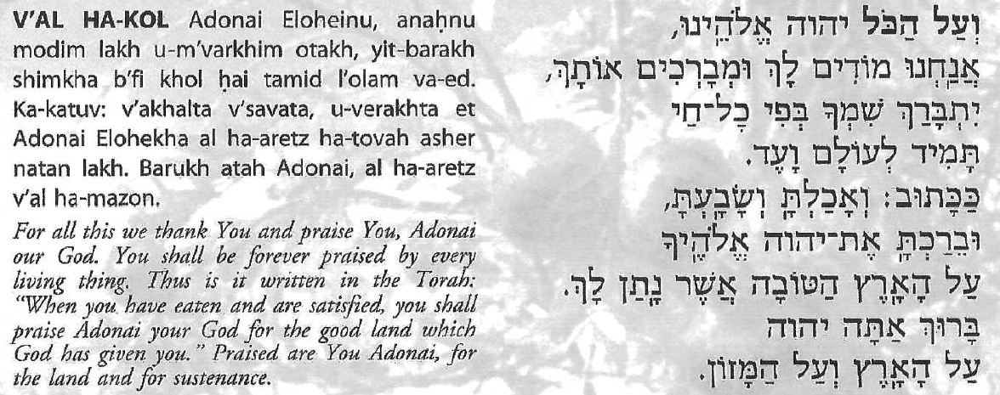
Musical Motifs-- Birkat Ha’artez

Slide 12
Let’s sing!

Slide 13
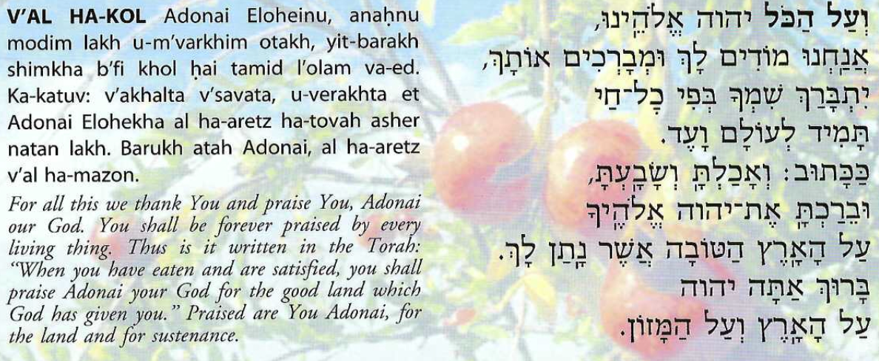

Slide 14
Musical Motifs-- Birkat Yerushalayim

Slide 15
Musical Motifs– Birkat Yerushalayim

Slide 16
Musical Motifs– Birkat Yerushalayim

Slide 17
Let’s sing!

Slide 20
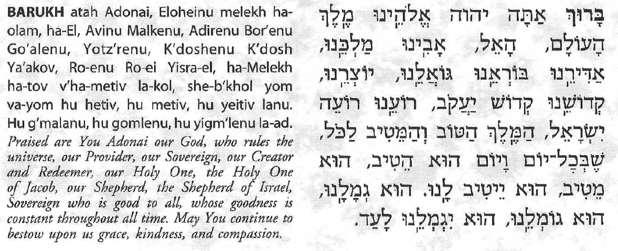
Communal Singing with Motivic Transitions-- Birkat Ha-tov v’Hametiv

Slide 21
Let’s sing!

Slide 22
Harachaman

Slide 23
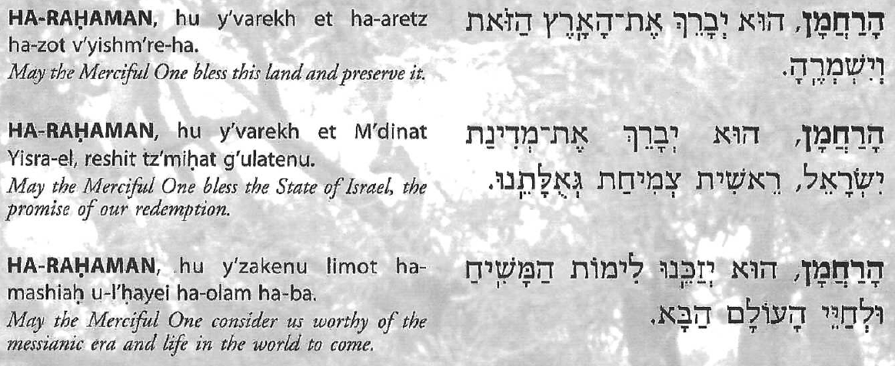
Harachaman

Slide 24
Let’s sing!

Slide 25
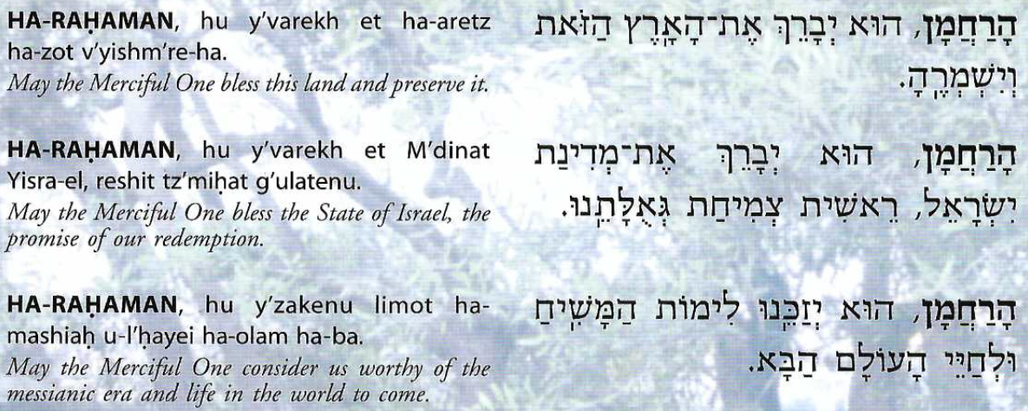

Slide 26
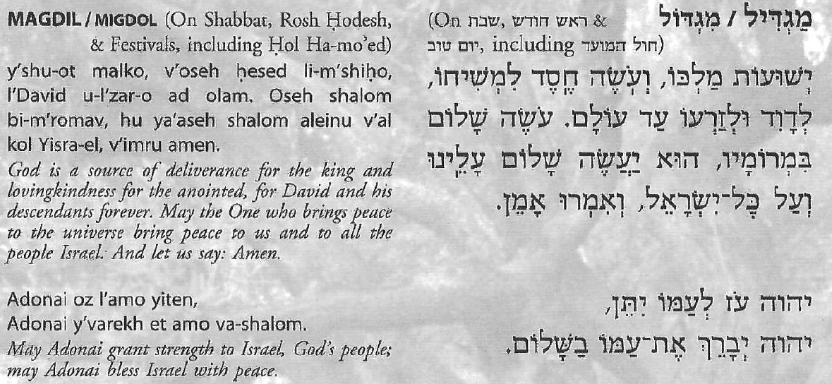
Communal Singing-- Closing Melodies

Slide 27
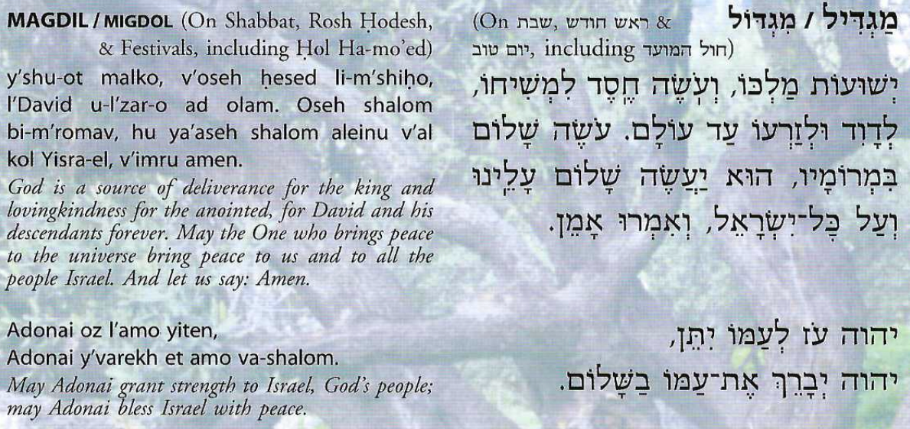
Let’s sing!

Slide 28
Alternative-- Brich Rachamana
Aramaic: Babylonian Talmud English: Rabbi Shefa Gold
Lyrics
בריך רחמנא מלכא דעלמא מריה דהאי פיתא Brikh raḥamana Malka d'alma Ma'arey d'hi (oh!) pita You are the source of Life for all that is And your blessing Flows through me

Slide 29
Shefa Gold
Melody
https://hazon.bandcamp.com/track/brich-rachamana
Sheet Music
https://velveteenrabbi.blogs.com/blog/2012/09/brich-rachamana-now-with-sheet-music.html

Slide 30
Resources
Text Study
https://www.sefaria.org/Birkat_Hamazon%2C_Birkat_Hamazon%2C_Preliminary_Psalms?lang=bi
Links for Listening to Birkat Hamazon
https://www.wlcj.org/resources/resources-for-members-and-friends/?fbclid=IwAR1UKDbVg4HefyHiYhLNJoSKZyJ5sbf_IZEM4zobdJuHKMO3dQ0z1P9XldM

Slide 31
Thank you!

